Slide 1
Chapter 1
Introduction to Databases

Slide 2
Chapter 1 - Objectives
Some common uses of database systems.
Characteristics of file-based systems.
Problems with file-based approach.
Meaning of the term database.
Meaning of the term Database Management System (DBMS).

Slide 3
Chapter 1 - Objectives
Typical functions of a DBMS.
Major components of the DBMS environment.
Personnel involved in the DBMS environment.
History of the development of DBMSs.
Advantages and disadvantages of DBMSs.

Slide 4
Examples of Database Applications
Purchases from the supermarket
Purchases using your credit card
Booking a holiday at the travel agents
Using the local library
Taking out insurance
Renting a video
Using the Internet
Studying at university

Slide 5
File-Based Systems
Collection of application programs that perform services for the end users (e.g. reports).
Each program defines and manages its own data.

Slide 6
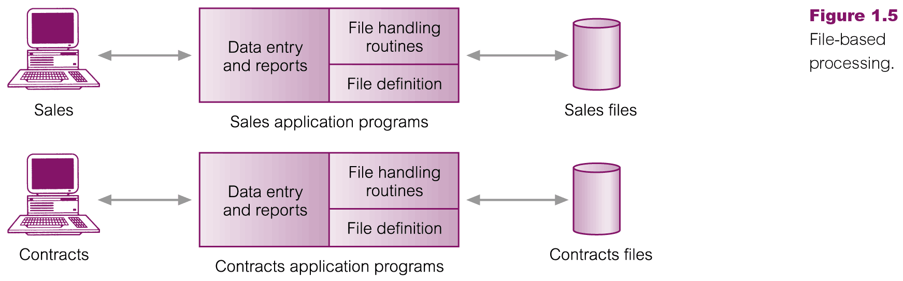
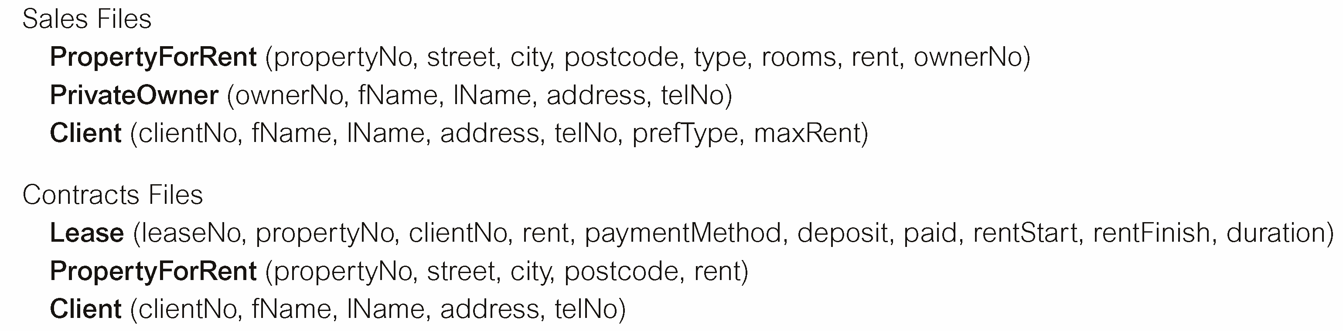
File-Based Processing

Slide 7
Limitations of File-Based Approach
Separation and isolation of data
  Each program maintains its own set of data.
  Users of one program may be unaware of potentially useful data held by other programs.
Duplication of data
  Same data is held by different programs.
  Wasted space and potentially different values and/or different formats for the same item.

Slide 8
Limitations of File-Based Approach
Data dependence
  File structure is defined in the program code.
Incompatible file formats
  Programs are written in different languages, and so cannot easily access each other’s files.
Fixed Queries/Proliferation of application programs
  Programs are written to satisfy particular functions.
  Any new requirement needs a new program.

Slide 9
Database Approach
Arose because:
  Definition of data was embedded in application programs, rather than being stored separately and independently.
  No control over access and manipulation of data beyond that imposed by application programs.
Result:
  the database and Database Management System (DBMS).

Slide 10
Database
Shared collection of logically related data (and a description of this data), designed to meet the information needs of an organization.
System catalog (metadata) provides description of data to enable program–data independence.
Logically related data comprises entities, attributes, and relationships of an organization’s information.

Slide 11
But what is data? And where is it now?
Data is factual information about objects and concepts, such as:
  measurements
  statistics
  You can find it in:
  filing cabinets
  spreadsheets
  folders
  lists
  colleagues’ memories
  piles of papers on your desk
Notes:
We use data for discussion, or calculation. It could be a person, a place, an event, an action, any one of a number of things. A single fact is an element of data, or a data element.
Data is stored in many places, including our heads. But because of the mechanical nature of databases, they have terrific power to manage and process the information they hold. This can make the information they house much more useful for your work.
With this understanding of data, we can start to see how a tool with the capacity to store a collection of data and organise it especially for rapid search, retrieval and processing might make a difference to how we can use data. This is all about managing information.

Slide 12
What does “managing information” mean?
Making information work for us
Making information useful
Avoiding "accidental disorganisation”
Making information easily accessible and integrated with the rest of our work

Slide 13
Database Management System (DBMS)
A software system that enables users to define, create, maintain, and control access to the database.
(Database) application program: a computer program that interacts with database by issuing an appropriate request (SQL statement) to the DBMS.

Slide 14
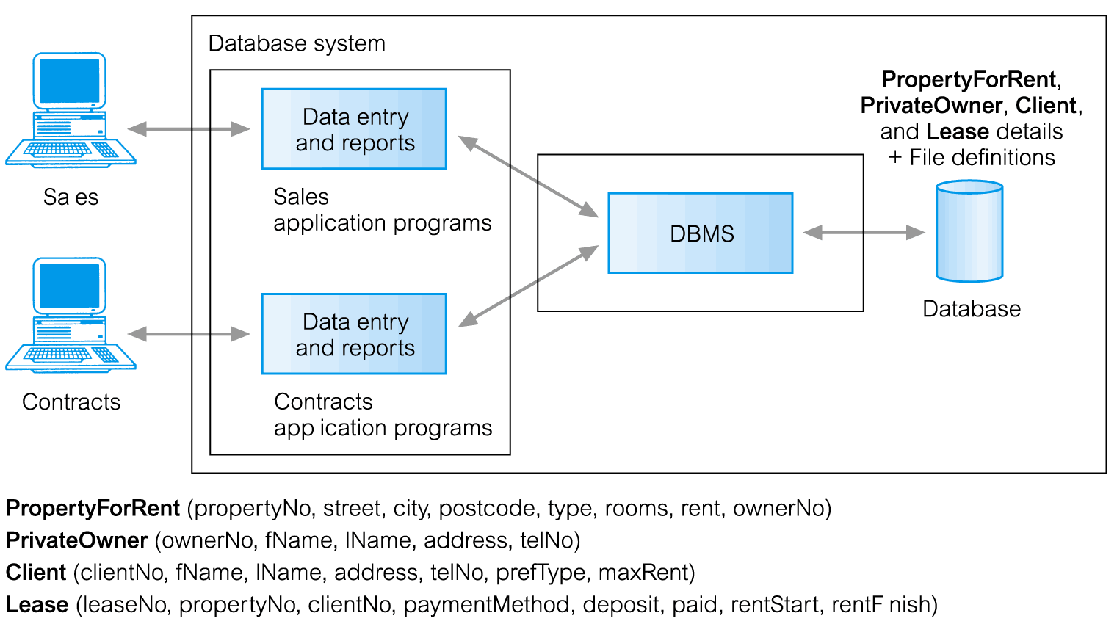
Database Management System (DBMS)

Slide 15
Database Approach
Data definition language (DDL).
  Permits specification of data types, structures and any data constraints.
  All specifications are stored in the database.
Data manipulation language (DML).
  General enquiry facility (query language) of the data.

Slide 16
Database Approach
Controlled access to database may include:
  a security system
  an integrity system
  a concurrency control system
  a recovery control system
  a user-accessible catalog.

Slide 17
Views
Allows each user to have his or her own view of the database.
A view is essentially some subset of the database.

Slide 18
Views - Benefits
Reduce complexity
Provide a level of security
Provide a mechanism to customize the appearance of the database
Present a consistent, unchanging picture of the structure of the database, even if the underlying database is changed

Slide 19
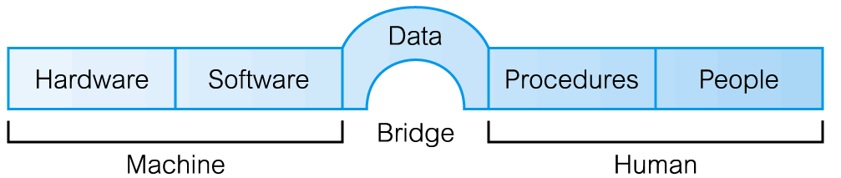
Components of DBMS Environment

Slide 20


Components of DBMS Environment
DBMS
===============
Design tools
Table Creation
Form Creation
Query Creation
Report Creation
Procedural
language
compiler (4GL)
=============
Run time
Form processor
Query processor
Report Writer
Language Run time
Database
Application
Programs
Database contains:
User’s Data
Metadata
Indexes
Application Metadata
User
Interface
Applications

Slide 21
Components of DBMS Environment
Hardware
  Can range from a PC to a network of computers.
Software
  DBMS, operating system, network software (if necessary) and also the application programs.
Data
  Used by the organization and a description of this data called the schema.

Slide 22
Components of DBMS Environment
Procedures
  Instructions and rules that should be applied to the design and use of the database and DBMS.
People
  Includes database designers, DBAs, application programmers, and end-users.

Slide 23
Roles in the Database Environment
Data Administrator (DA)
  Database planning
  Development and maintenance of standards, policies and procedures
Database Administrator (DBA)
  Physical realization of database
  Physical DB design and implementation
  Security and integrity control
  Maintenance of operational system
Database Designers (Logical and Physical)
  Identifying the data, relationship between data and constrain on data
  Mapping the logical DB design into tables and constraints
Application Programmers
End Users (naive and sophisticated)

Slide 24
History of Database Systems
First-generation
  Hierarchical Model (1960’s and 1970’s)
    Similar to data structures in programming languages.
Books
(id, title)
Authors
(first, last)
Publisher
Subjects

Slide 25
History of Database Systems
Network Model (1970’s)
  Provides for single entries of data and navigational “links” through chains of data.
Problems:
  Changes in data structure require changes in application programs that access that structure
  No Many-to-Many relationships
  Programmers must be thoroughly familiar with the database structure.
Authors
Subjects
Books
Publishers

Slide 26
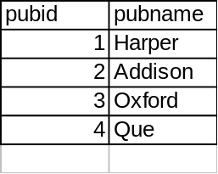
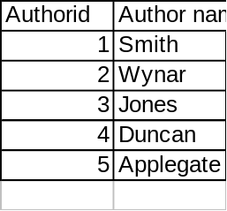
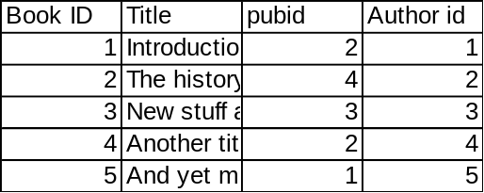
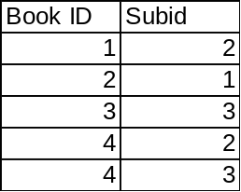
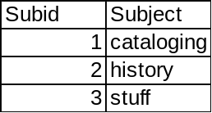
History of Database Systems
Second generation
  Relational Model (1980’s)
    Provides a conceptually simple model for data as relations (typically considered “tables”) with all data visible.
Advantage: Many-to-Many relationships are implemented
Problems: “Navigation” is even harder

Slide 27
History of Database Systems
Third generation
  Object-Oriented
    Encapsulates data and operations as “Objects”
Books
(id, title)
Authors
(first, last)
Publisher
Subjects

Slide 28
History of Database Systems
Object-Relational (1990’s)
  Combines the well-known properties of the Relational Model with such OO features as:
    User-defined datatypes
    User-defined functions
    Inheritance and sub-classing

Slide 29
Advantages of DBMSs
Control of data redundancy
Data consistency
More information from the same amount of data
Sharing of data
Improved data integrity
Improved security
Enforcement of standards
Economy of scale

Slide 30
Advantages of DBMSs
Balance conflicting requirements
Improved data accessibility and responsiveness
Increased productivity
Improved maintenance through data independence
Increased concurrency
Improved backup and recovery services

Slide 31
Disadvantages of DBMSs
Complexity
Size
Cost of DBMS
Additional hardware costs
Cost of conversion
Performance
Higher impact of a failure

